Slide 1
Lecture 8 Deep Learning & Convolutional Neural Networks
CS582
Machine Learning: Getting Computers
to Program Themselves
“Discovering the Learning Dynamics of the Laws of Nature”
Dr. Emdad Khan
ekhan@miu.edu
Prof. of Computer Science
Maharishi International University
Mary 2023

Slide 2
Deep Learning
So far we have used Neural Network (or other learning systems) to perform the learning function.
Input data preprocessing steps(s ) was done with several other methods including mathematical tools for feature extraction (edges from pixels in an image, mfcc from audio input etc).
Can we also extract key features in an automated way using e.g. a Neural Network?

Slide 3
Deep Learning
The answer is YES.
Deep Learning is basically all about this!
It has been proven to be very useful and successful, especially, for image and object classification / recognition.
[Acknowledgement] Some slides are from Prof. Andrew Ng at Stanford University.

Slide 4
Key Idea of Deep Learning
We use the “Autoencoding” theme that we covered when discussed NN. “Autoencoding” does data compression when smaller number of hidden neurons than in the input layer are used as you might remember.
Data compression forces to represent the input with features that have more insights.
Continuing this way with multiple “Autoencoding” in a sequence can extract very important detailed features from noisy input and thus, can help classify complex objects well.
This is the basic idea of Deep Learning.

Slide 5
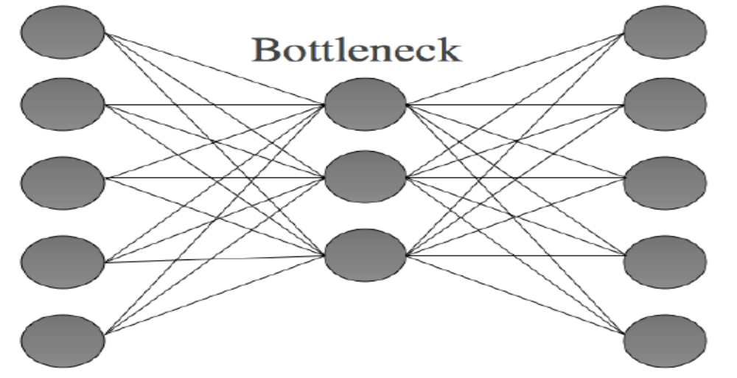
Autoencoding
Make output (target) same as Inputs

Slide 6
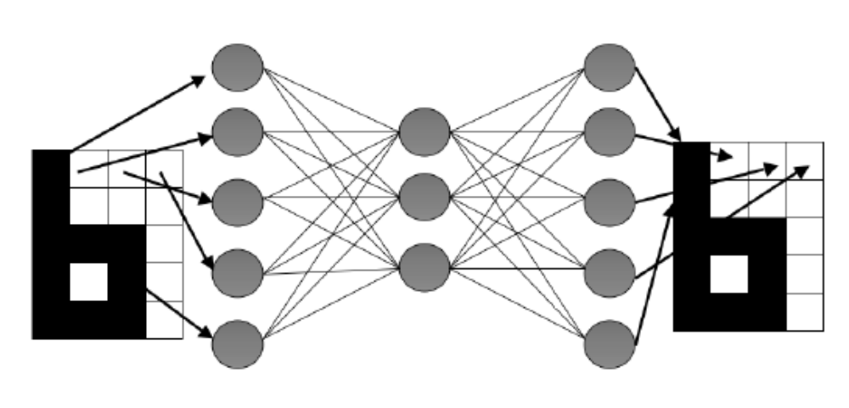
The Auto-Associative Network
Less number of hidden units forces Data compression and learns about the Input features.

Slide 7
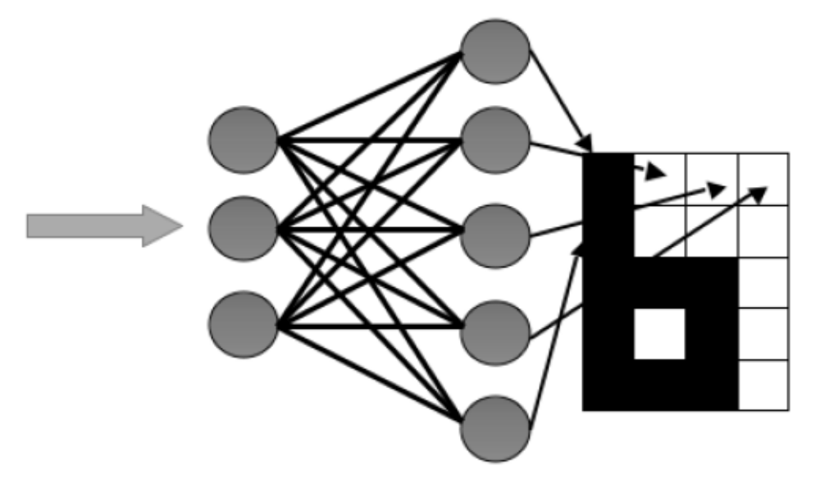
The Auto-Associative Network
Inputs and input layer weights can be removed after learning, saving storage.
Compressed encoded values when applied will produce the noise free input.

Slide 8

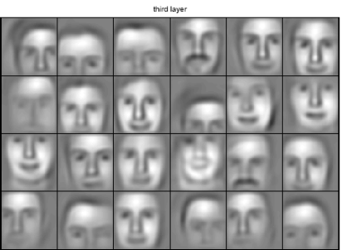
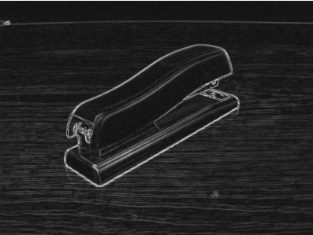
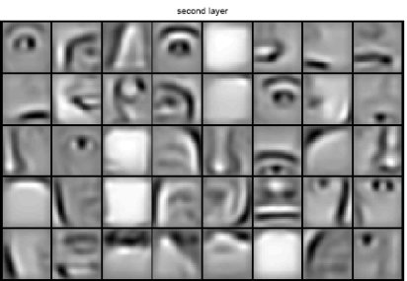

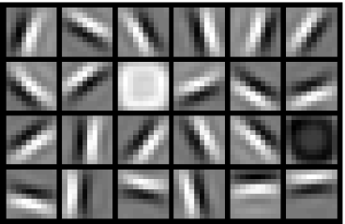
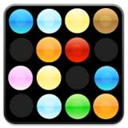
Why feature hierarchies
object models
object parts
(combination
of edges)
edges
pixels

Slide 9
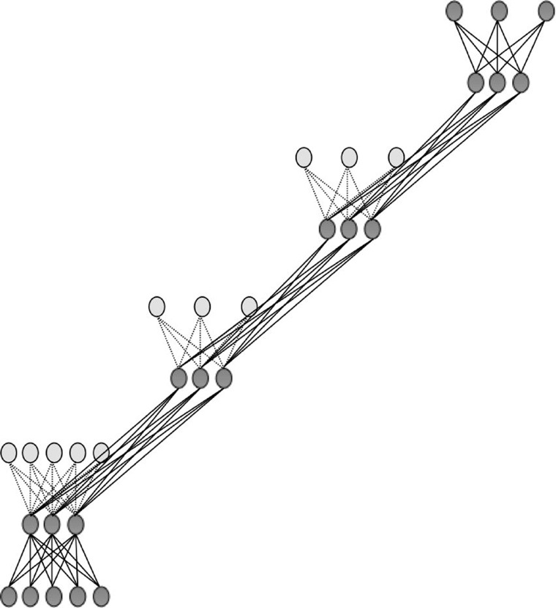
Deep Learning – Staggered Auto-Encloders
FIGURE 17.13 A schematic of a deep network built up of a set of autoencoders. The hidden layer of one autoencoder, which provides a representation of the input data it sees, is used as the input to the next one. The second half of each autoencoder, which is the reconstruction of the inputs, is shown in lighter grey and with dotted weight lines.

Slide 10
Details of Deep Learning
Use PPT from Prof. Andrew Ng, Stanford University (Another file)

Slide 11
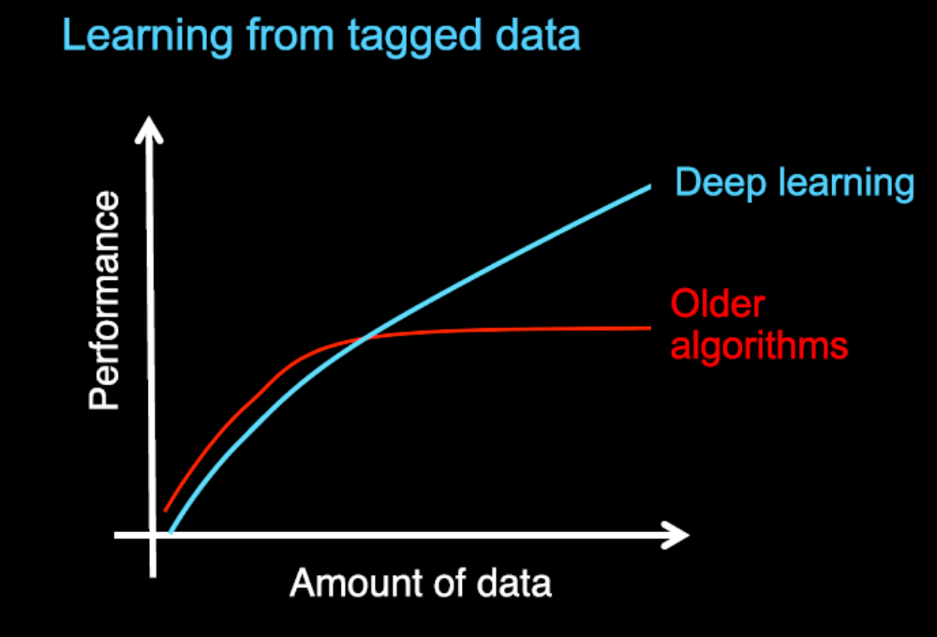
Deep Learning: Comparison with Existing Methods
From Andrew Ng - Deep Learning curve is for numerical data.
For unstructured data, it will be less effective as the main feature is “semantics” which cannot be represented with numbers

Slide 12
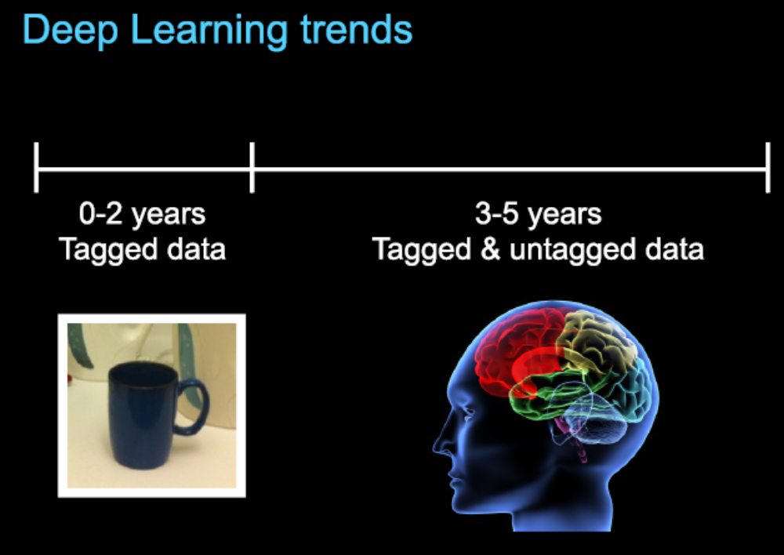
Deep Learning Trend

Slide 13
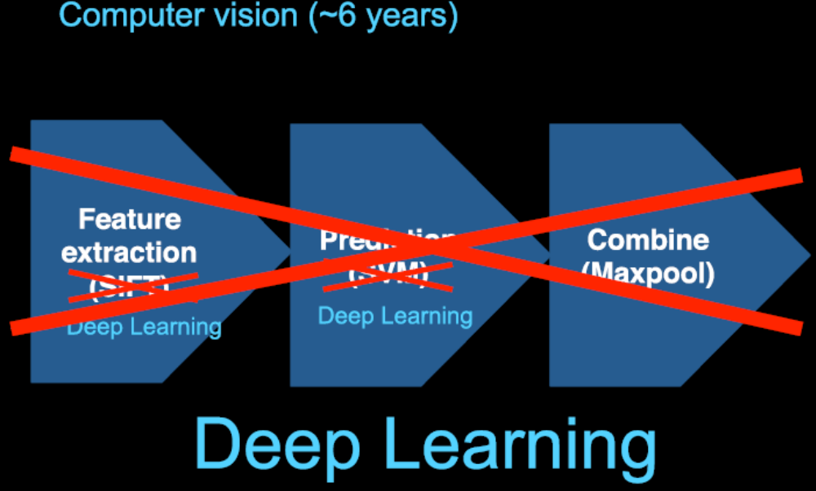
Deep Learning Trend
NN will do both Feature extraction and Classification

Slide 14
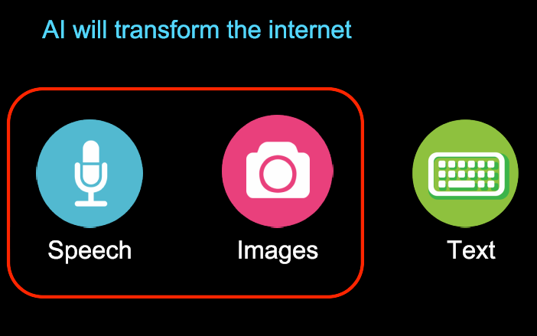
Deep Learning Trend
Similar to the “Intelligent Internet” we discussed

Slide 15
Convolutional Neural Networks
cs231n.github.io/convolutional-networks/

Slide 16

Convolution-1
Basically multiply 2 functions with moving time window.
Work as a filter (next slide)

Slide 17
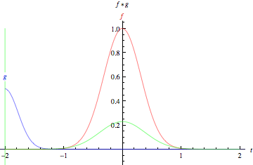
Convolution Demo

Slide 18
Convolutional Neural Networks (CNNs / ConvNets) - 1
Regular NN has too many connections (fully connected)
Does not scale well especially, for images.
Regular NN usually does not consider Spatial feature (except SOM where we have seen 2 D Neurons).
CNN uses similar ideas of Spatial features (receptive fields) as we discussed in SOM. It uses 3D spatial features.
It is also biologically motivated NN.

Slide 19
Convolutional Neural Networks (CNNs / ConvNets) - 2
CNN uses 3D (Volume) Neuron approach
It uses Spatial inputs as used in our eyes (receptive field or hearing.
CNN is good for small or large images e.g. (size 32x32x3 (32 wide, 32 high, 3 color channels) to 200*200*3)
CNN Basically uses Convolution to explore key features from an object. It basically automates the feature extraction process and help better object recognition.

Slide 20
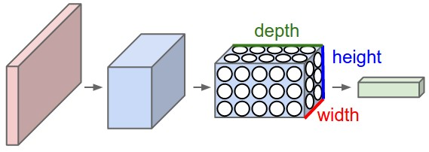
CNN Typical Architecture
A ConvNet arranges its neurons in three dimensions (width, height, depth), as visualized in one of the layers. Every layer of a ConvNet transforms the 3D input volume to a 3D output volume of neuron activations. In this example, the red input layer holds the image, so its width and height would be the dimensions of the image, and the depth would be 3 (Red, Green, Blue channels).

Slide 21
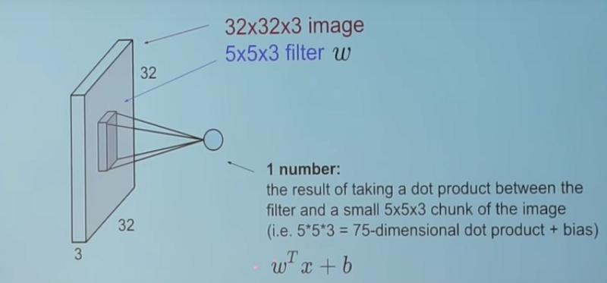
CNN Typical Architecture

Slide 22
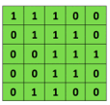
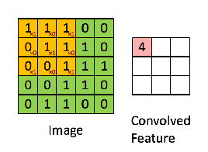

Convolution Process in Neural CNN
Convolutional Neural Networks
Convolutional neural networks (CNNs) were primarily designed for image data
CNNs use a convolutional operator for extracting data features
  Allows parameter sharing
  Efficient to train
  Have less parameters than NNs with fully-connected layers
CNNs are robust to spatial translations of objects in images
A convolutional filter slides (i.e., convolves) across the image
Convolutional
3x3 filter
Input matrix
Picture from: http://deeplearning.stanford.edu/wiki/index.php/Feature_extraction_using_convolution

Slide 23
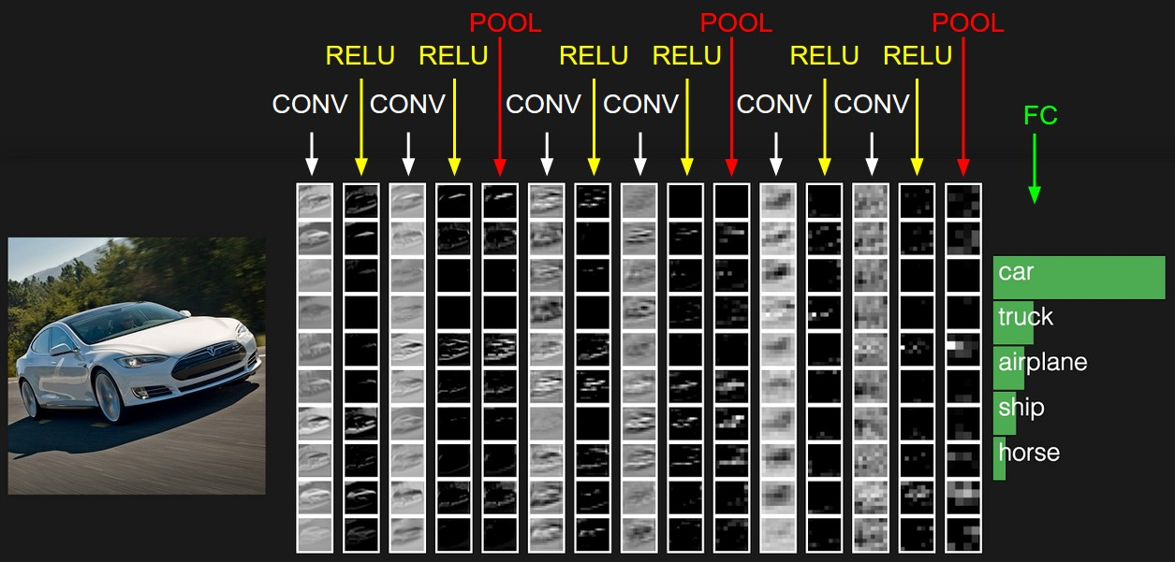
Activations in a CNN
The activations of an example ConvNet architecture. The initial volume stores the raw image pixels (left) and the last volume stores the class scores (right). Each volume of activations along the processing path is shown as a column. Since it's difficult to visualize 3D volumes, we lay out each volume's slices in rows. The last layer volume holds the scores for each class, but here we only visualize the sorted top 5 scores, and print the labels of each one. The full web-based demo is shown in the header of our website.

Slide 24



Why Relu - AvoidVanishing Gradient Problem
Training Neural Networks
In some cases, during training, the gradients can become either very small (vanishing gradients) of very large (exploding gradients)
  They result in very small or very large update of the parameters
  Solutions: change learning rate, ReLU activations, regularization, LSTM units in RNNs
……
y₁
……
y₂
……
……
……
……
……
……
y_{M}
Small gradients, learns very slow
Slide credit: Hung-yi Lee – Deep Learning Tutorial

Slide 25
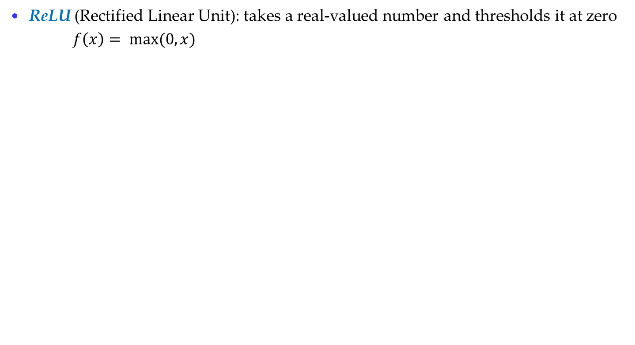

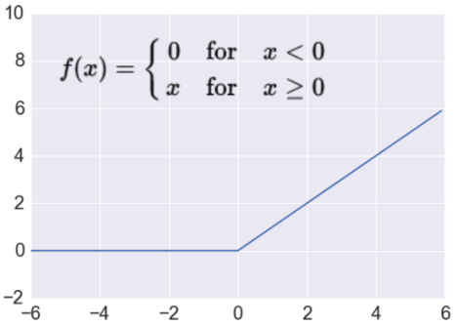


Activation: ReLU
Introduction to Neural Networks
  Most modern deep NNs use ReLU activations
  ReLU is fast to compute
    Compared to sigmoid, tanh
    Simply threshold a matrix at zero
  Accelerates the convergence of gradient descent
    Due to linear, non-saturating form
  Prevents the gradient vanishing problem

Slide 26
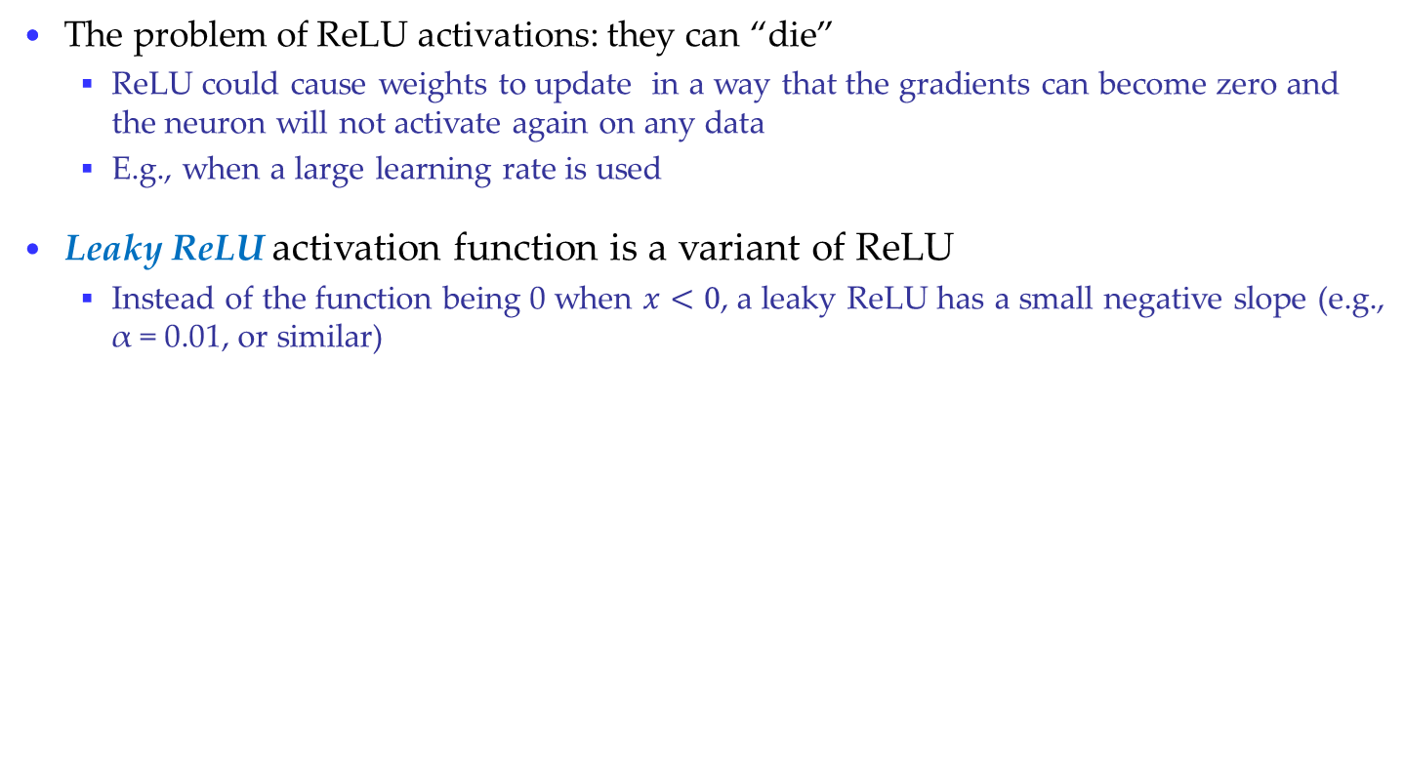
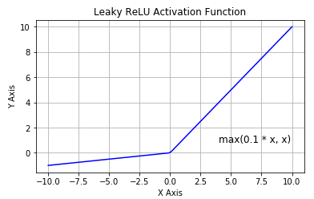
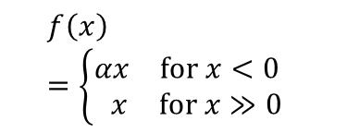
Activation: Leaky ReLU
Introduction to Neural Networks
  This resolves the dying ReLU problem
  Most current works still use ReLU
    With a proper setting of the learning rate, the problem of dying ReLU can be avoided

Slide 27
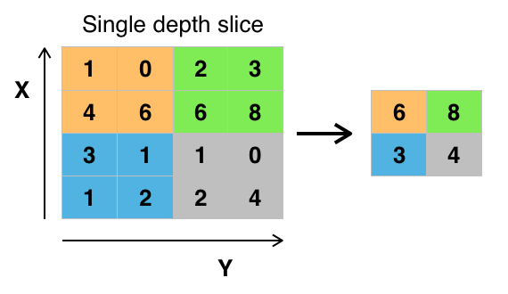
Pooling Layer
Another important concept of CNNs is pooling, which is a form of non-linear down-sampling. There are several non-linear functions to implement pooling among which max pooling is the most common. It partitions the input image into a set of non-overlapping rectangles and, for each such sub-region, outputs the maximum.
Reduces weights / parameters and help prevent overfitting.

Slide 28
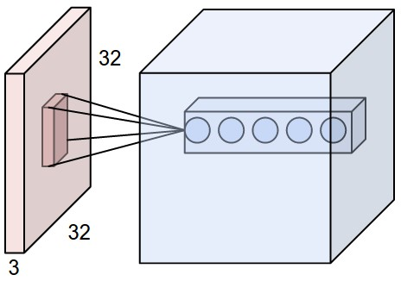
More on a Convolutional Layer
An example input volume in red (e.g. a 32x32x3 CIFAR-10 image), and an example volume of neurons in the first Convolutional layer. Each neuron in the convolutional layer is connected only to a local region in the input volume spatially, but to the full depth (i.e. all color channels). Note, there are multiple neurons (5 in this example) along the depth, all looking at the same region in the input - see discussion of depth columns in text below.

Slide 29
About Depth Column
The depth of the output volume is a hyperparameter: it corresponds to the number of filters we would like to use, each learning to look for something different in the input.
For example, if the first Convolutional Layer takes as input the raw image, then different neurons along the depth dimension may activate in presence of various oriented edges, or blobs of color.
We will refer to a set of neurons that are all looking at the same region of the input as a depth column (some people also prefer the term fibre).
Also, in each depth column, there are depth slices – e.g. we can consider one depth volume for one filter (e.g. edge or arc; see parameter sharing slide later).

Slide 30
Zero Padding, Stride etc
Zero-padding refers to the process of symmetrically adding zeroes to the input matrix. It's a commonly used modification that allows the size of the input to be adjusted to our requirement. It is mostly used in designing the CNN layers when the dimensions of the input volume need to be preserved in the output volume (denoted by P).
Input window size is represented by W.
Moving window size, S
Receptive field size is F. Then,
the correct formula for calculating how many neurons “fit” is given by (W−F+2P)/S+1

Slide 31
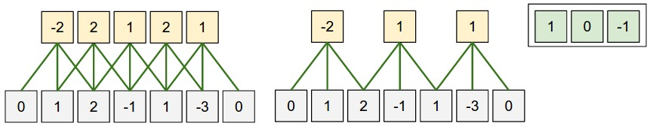
Illustration of a Spatial Arrangement
Weights
Illustration of spatial arrangement. In this example there is only one spatial dimension (x-axis), one neuron with a receptive field size of F = 3, the input size is W = 5, and there is zero padding of P = 1. Left: The neuron strided across the input in stride of S = 1, giving output of size (5 - 3 + 2)/1+1 = 5. Right: The neuron uses stride of S = 2, giving output of size (5 - 3 + 2)/2+1 = 3. The neuron weights are in this example [1,0,-1] (shown on very right), and its bias is zero. These weights are shared across all yellow neurons (see parameter sharing in next slide.). Neurons on the top, below are the inputs.

Slide 32
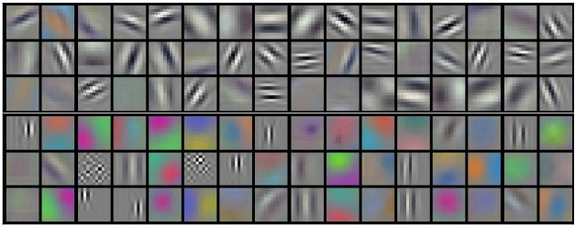
Example Filters
Example filters learned by Krizhevsky et al. Each of the 96 filters shown here is of size [11x11x3], and each one is shared by the 55*55 neurons in one depth slice. Notice that the parameter sharing assumption is relatively reasonable: If detecting a horizontal edge is important at some location in the image, it should intuitively be useful at some other location as well due to the translationally-invariant structure of images. There is therefore no need to relearn to detect a horizontal edge at every one of the 55*55 distinct locations in the Conv layer output volume. Also, weights of neurons at each depth slice is different in a depth volume i.e. different depth slice has different weights at different depths in a depth volume but across the Conv layer weights at a particular depth are same for the same filter (due to parameter sharing).
Refer to - https://cs231n.github.io/convolutional-networks/ for more.

Slide 33
Convolution Demo
http://cs231n.github.io/convolutional-networks/

